Slide 1
Elixir Workshop
Day 2

Slide 2
Working with Modules - alias
We use alias for setting-up module aliases
defmodule MyApp.Calculator do
def add(a, b), do: a + b
...
defmodule MyApp.Main do
alias MyApp.Calculator, as: Calc
def run() do
Calc.add(1, 2)
|> IO.inspect()
defmodule MyApp.Calculator do
def add(a, b), do: a + b
...
defmodule MyApp.Main do
alias MyApp.Calculator
def run() do
Calculator.add(1, 2)
|> IO.inspect()

Slide 3
Working with Modules - import
We use import for accessing public module functions without referencing the full function name
defmodule MyApp.Calculator do
def add(a, b), do: a + b
...
defmodule MyApp.Main do
import MyApp.Calculator
def run() do
add(1, 2) |> IO.inspect() # from Calculator module

Slide 4
Macros and use
Macros are a way to generate custom code at compile time
Used for metaprogramming/DSL
The keyword use injects code from a macro by calling the __using__ callback
Macros are often used when defining “interface” modules, with functions that have to be implemented

Slide 5
Macros and use (2)
defmodule MyApp.Calculator do
defmacro __using__(opts) do
if opts[:financial] == true do
quote do
def add_money(a, b), do: "Adding sums of money..."
end
end
end
def add(a, b), do: a + b
end
defmodule MyApp do
use MyApp.Calculator, financial: true
def start() do
add_money(1, 2)
|> IO.inspect
# Adding sums of money...
end
end

Slide 6
Behaviors
Behavior modules are like interfaces in other languages
They contain method definitions only, annotated with @callback
The module that implements the behavior uses the @behavior and @impl annotations

Slide 7
Behaviors (2)
defmodule MyApp.Formatter do
@callback format(String.t) :: {:ok, String.t}
End
defmodule MyApp.JsonFormatter do
@behaviour MyApp.Formatter
@impl true
def format(content) do
{:ok, "Here is some JSON content: #{content}"}
end
end

Slide 8

Demo

Slide 9
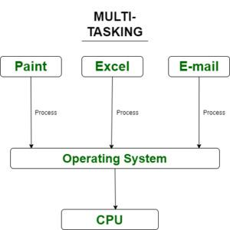
A brief history of multitasking
The first operating systems were single-tasked
You can execute one operation at a time
The user experience was bad
The resources were not utilized properly
To solve this, multi-tasking OS were created

Slide 10
Types of multi-tasking
Pre-emptive
The OS gives some CPU time to a process
If the process doesn’t complete, the OS switches to another process
This is called context switching
Processes have priority
Cooperative
The OS gives CPU time to a process
Then waits for the process to voluntarily release CPU
It’s rarely used nowadays

Slide 11
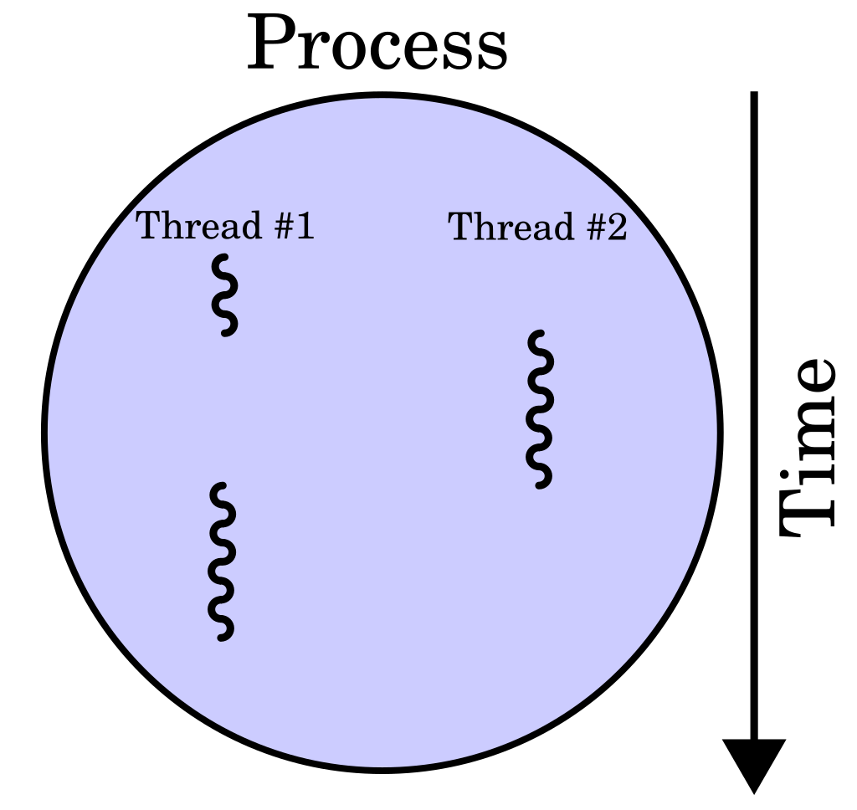
What are OS threads?
A sequence of instructions
More lightweight than OS processes
Each OS process can run multiple threads in parallel
Managed by the OS

Slide 12
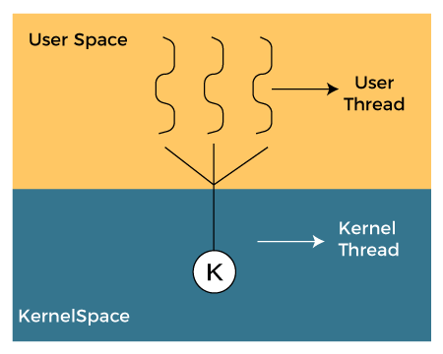
Kernel threads vs user threads
OS (Kernel) threads disadvantages:
Expensive creation and management
Context-switching is slow
User (application) threads come to the rescue
Also named green threads, routines etc.
Managed by the application
Lighter, fast context switching
True parallelism (on multiple cores) is not always easy
Both types share the same memory

Slide 13
Some thoughts on concurrency
Concurrency, parallelism and multithreading are not the same thing
We can achieve true parallelism only with multiple cores
We can have concurrency with a single OS thread (e.g. NodeJS, green threads)
2x more threads doesn’t mean 2x faster performance

Slide 14
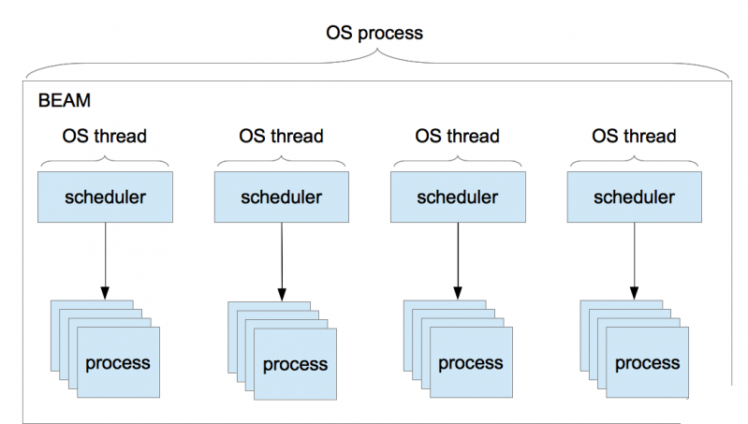
BEAM concurrency model
BEAM VM has its own scheduler
Runs lightweight processes
No shared state
Communication via message passing
… sounds familiar?

Slide 15
Concurrency model benefits
Better performance (no locks)
Fault tolerance
Easier to distribute
Built-in load balancing
All cores are used
Hot deployment
Scalability – up to ~268M running processes

Slide 16
Processes
All code in Elixir runs inside a process
Spawning a new process is very easy
When spawned, the process receives an ID from the scheduler
iex> spawn(fn -> 1 + 2 end)
#PID<0.113.0>

Slide 17
Sending and receiving messages
We use the send and receive functions for communication between processes
parent = self() # PID<0.41.0>
spawn(fn -> send(parent, {:hello, self()}) end) # PID<0.48.0>
receive do
{:hello, pid} -> "Got hello from #{inspect pid}"
end
# "Got hello from #PID<0.48.0>"

Slide 18
Linking Processes
By default processes are independent
If we want the error in a child process to propagate to the parent, we use spawn_link
Linking is a core feature of BEAM
Used in patterns like supervisor trees

Slide 19
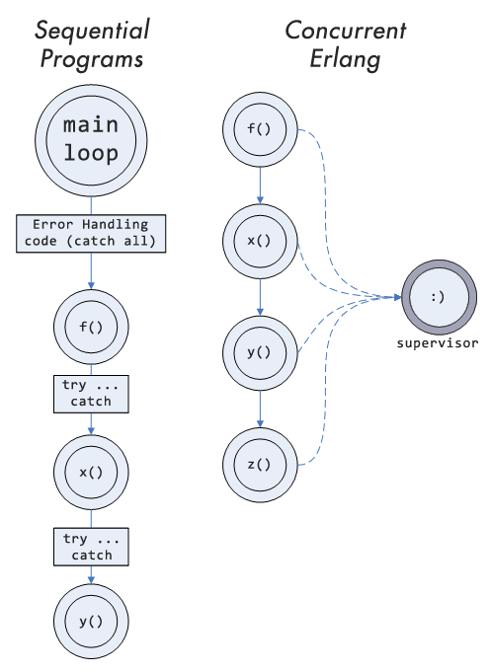
Let it crash?
A type of “fail fast” approach
Error-handling is decoupled from the business logic
Supervisors take care of errors
We handle edge cases in the code
Since processes are isolated and cheap, a process crashing is not a big deal
We can always restart a process

Slide 20
Demo

Slide 21
Tasks
Tasks are wrappers for processes
The Task module provides functions for starting, linking and awaiting tasks
We can create complex task hierarchies with the Task.Supervisor module

Slide 22
Agents
We cannot access the process state by default (immutable state)
In order to keep and access state, we use Agents
{:ok, pid} = Agent.start_link(fn -> %{} end) # {:ok, #PID<0.124.0>}
Agent.update(pid, fn state -> Map.put(state, "name", "John") end)
Agent.get(pid, fn state -> state end)
# %{"name" => "John"}
Agent.get(pid, fn state -> state["name"] end)
# "John"

Slide 23
GenServers
A behavior for implementing a server module
Can handle both sync and async calls
defmodule Stack do
use GenServer
@impl true
def init(initial_state) do # initial state
. . .
@impl true
def handle_call(:pop, _from, state) do # for sync calls
. . .
@impl true
def handle_cast({:push, element}, state) do # for async calls
...

Slide 24
GenServers (2)
We interact with the GenServer like it’s a regular process
{:ok, pid} = GenServer.start_link(Stack, "hello world")
GenServer.call(pid, :pop) # sync
# "hello world"
GenServer.cast(pid, {:push, "test"}) # async
# :ok

Slide 25
Demo

Slide 26
Introduction to Mix
Mix is the default build tool for Elixir applications
Used for creating projects, compiling, managing dependencies, testing etc.
Similar to Gradle/Vite/dotnet CLI
Basic commands:
Creating a project: mix new
Compiling: mix compile
Testing: mix test
Running: mix run
Running in interactive mode: iex –S mix …

Slide 27
Applications
The standard way to package Elixir projects
Each application has a main module
It should implement the Application behavior
defmodule MyApp.MixProject do
def application do
[
mod: {MyApp, []},
]
end
. . .
end
defmodule MyApp do
use Application
def start(_type, _args) do
IO.puts("Hello world")
{:ok, self()}
end
end

Slide 28
Demo

Slide 29
Q & A

Slide 30
Thank you

